Slide 1
Amazon company
Student’s Name
Institutional Affiliation
Date

Slide 2
Table of contents
Executive summary
Company background
The brand concept
Amazon platform
Brand implementation
Role of interactivity and trust in amazon
Recommendations
References
Appendix

Slide 3
Executive summary
Amazon.com, Inc. is one of the multinational American based companies that concentrate on artificial intelligence, e-commerce, digital streaming and cloud computing.
Jeff Bezos started the e-retailer in 1994 as an online bookstore. It was based in Seattle, Washington (Moagar-Poladian et al. 2017).
From an online bookstore, Amazon has become a reliable and large e-commerce retailer in the world.
The company has developed a strong brand that has enabled its success in the world of e-commerce.
Currently, the company has expanded its operations to cover the video streaming of markets and banking

Slide 4
Cont…
It is out of this expansion that has to enable amazon to be ranked the fourth most valuable in the world after Microsoft, apple and alphabet.
Amazon has developed storefront websites in numerous countries that have enabled the company ship products almost in all countries of the world.
The company owns other companies like Lacoste, Marks & Spencer, and Sears Canada (Moagar-Poladian et al. 2017).
It is also associated with Diapers.cm, IMDb, Goodreads and Zappos brands. Amazon e-retail brand is to allow businesses and individuals to display products for sale, sell products and buy online.

Slide 5
Cont…
Its online platform is available in numerous countries and in different languages giving people of diverse backgrounds to access the platform (Moagar-Poladian et al. 2017).
A board of directed Jeff Bezos manages the company as the president, CEO and chairman of the company.
Others board members include Jamie Gorelick, Jude McGrath, Indra Nooyi, Rosalind Brewer, Jon Rubinstein, Patty Stonesifer, Wendell P. Weeks, and Thomas O. Ryder.

Slide 6
Company background
According to Anh (2019), Amazon started as an online book store that sold its products to fifty states.
Jeff Bezos, the founder of the company in 1994, graduated from Princeton University with a Bachelor of Science in Engineering.
Jeff created this platform to explore the changes in technology that were rapidly the world.
The internet website was launched in 1995, where Jeff aimed at changing shopping experiences for books and provide more enjoyable services.
Though it is the largest online shopping platform, it has experienced ups and downs. The company enjoys a multi-billion dollar share of online sales.

Slide 7
Cont…
The company capitalized on its weaknesses to create a stronger brand that would compete more favorably with giant companies in e-retail commerce like Wal-Mart.
Jeff landed the name "Amazon" because it was the largest river in the world, and he wanted to create a platform that will dominate the world e-commerce.
The first company was in situated in his garage in Washington selling books and later video games, Blu-rays, DVDs, and CDs.
He then added furniture, food, toys and apparel. The company then started producing its products that diversified its customer preferences.
As such, the company started separate websites in different countries of the world to enable it to better to serve its customers.
The company is now the largest online retailer which recorded 100 million subscribers in 2018.

Slide 8
The brand concept
Amazon has a simple platform that enables selling and buying of products online.
The platform has enhanced the world of retail and world brands as an individual can acquire any product across the globe at any time.
This has been enhanced the daily use of the internet as it has become daily obligating of internet users.
Amazon as such aims at providing a wide range of products to its customers who has unbeatable prices, descriptions, opinions and content.
Also, amazon helps in branding acceleration through the use of expertise.

Slide 9
Cont…
This has led to creating an e-commerce platform that allows for product choice, timing promotion and pricing policing.
The brand guarantees effective operational management of the involved drivers.
This has enabled the company to carry out reviews in retail media, inventory management, and content and solve challenges created by e-commerce.
Amazon has developed a service united to enable the company to deal with these challenges.
Amazon thus aims at providing high-quality goods and services to the customers and operates within its budget (Moagar-Poladian et al. 2017).

Slide 10
Cont…
  The company desires to serve individuals from all backgrounds without discrimination on religion, race, gender, or country. This will enable the company to maximize profits.
  In an attempt to serve people, amazon is dedicated to ensuring customer satisfaction through well-thought-out values and morals that act as drivers of the company.
  These values are; invent and simplicity, ownership, customer obsession, insist on the highest standards, frugality, dive deep, think big, hire the best, and the highest deliver results.
  These values have enabled the company to serve its customers with a period of one week.

Slide 11
Amazon platform
Developing and managing an online platform can be challenging and thus require a variety of technological services and expertise.
The platform developed by any company should meet its objectives and be within its budget.
Amazon platform was designed to ease business that involved internet users. This was the functional role of the platform created by Jeff Bezos.
He developed this unique site to enable people market, buy and sell products across the platform.
It was also developed to ensure faster delivery of products which are reliable and with low-latency but with high-performance.

Slide 12
Cont…
The amazon cloud front enables the company to serve its customers across all locations of the globe.
Through the access management, the company can use sophisticated language to create and control groups and users of the site and give access permission to the users.
This is done through the Amazon Dynamo DB tables, Amazon EBS snapshots, or Amazon S3 storage buckets (Emerson 2019).

Slide 13
Brand implementation
Implementation of amazon platform has been vital in the success of the company. Its virtual servers have ranged from memory requirements, compute and network resources.
The platform was designed to make computing more manageable and allow developers to maintain the security of the platform.
It also includes code responses to enable the systems to manage and control events.
The platform also uses a wide variety of compute instances enable general compute purposes, which enable the balance between network resources, memory and compute resources (Emerson, 2019).
Memory optimization is used to enhance the maintenance of applications like a database.
It also uses flexibility options that allow changes in pricing and product changes.

Slide 14
Role of interactivity and trust in amazon
Digital designs are essential in enabling customers to experience in marketing.
Creating an interactive site will connect buyers and sellers in meaningful ways (Emerson, 2019).
Through interactive sites, customers get answers to their questions that improve their decision making.
creates trust in customers on amazon as an e-retailer. This is a trick used by amazon as it a for-profit oriented organization.
When Jeff invested in the e-retail, he created a platform that will generate trust to customers and enable the growth of the organization to its current status.

Slide 15
Cont…
Digital designs also increase conservation rate as the customers pay for products without asking much.
They as well increase personalization that creates more customized experiences.
Interactivity and trust also solidify the amazon brand that has ranked the organization among the top organizations in the world.
They also educate customers and potential customers about the core values of amazon and thus increase the consumption of its products (Jeon et al. 2017).

Slide 16
Recommendations
Amazon has been the largest e-commerce organization in the world but has chances of improving the provision of its services to customers.
As their website is not used all over the world, Jeff and his team should develop a system that can be accessed everywhere in the world.
This will increase its market and thus command more market power than any other e-retailer.
They should also make sure their customer has easy access to the information about e-retail.
This will involve a clear display of their pricing and shipping policies. This will create more trust to the customers.
There is little marketing of the organization, and thus the company should do more market for the company. This will create more awareness to potential customers.

Slide 17
References
Anh, T. (2019). Artificial intelligence in e-commerce: Case Amazon.
Emerson, K. Y. (2019). From Amazon's Domination of E-Commerce to Its Foray into Patent Litigation: Will Amazon Succeed as the District of Amazon Federal Court. NCJL & Tech., 21, 71.
Jeon, H., Jang, J., & Barrett, E. B. (2017). Linking website interactivity to consumer behavioural intention in an online travel community: The mediating role of utilitarian value and online trust. Journal of Quality Assurance in Hospitality & Tourism, 18(2), 125-148.
Moagar-Poladian, S., Dumitrescu, G. C., & Tanase, I. A. (2017). Retail e-Commerce (E-tail)-evolution, characteristics and perspectives in China, the USA and Europe. Global Economic Observer, 5(1), 167.

Slide 18
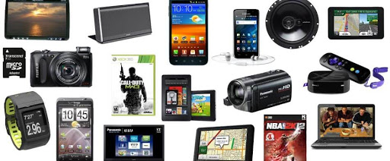
Appendix
Amazon products (electronics)

Slide 19
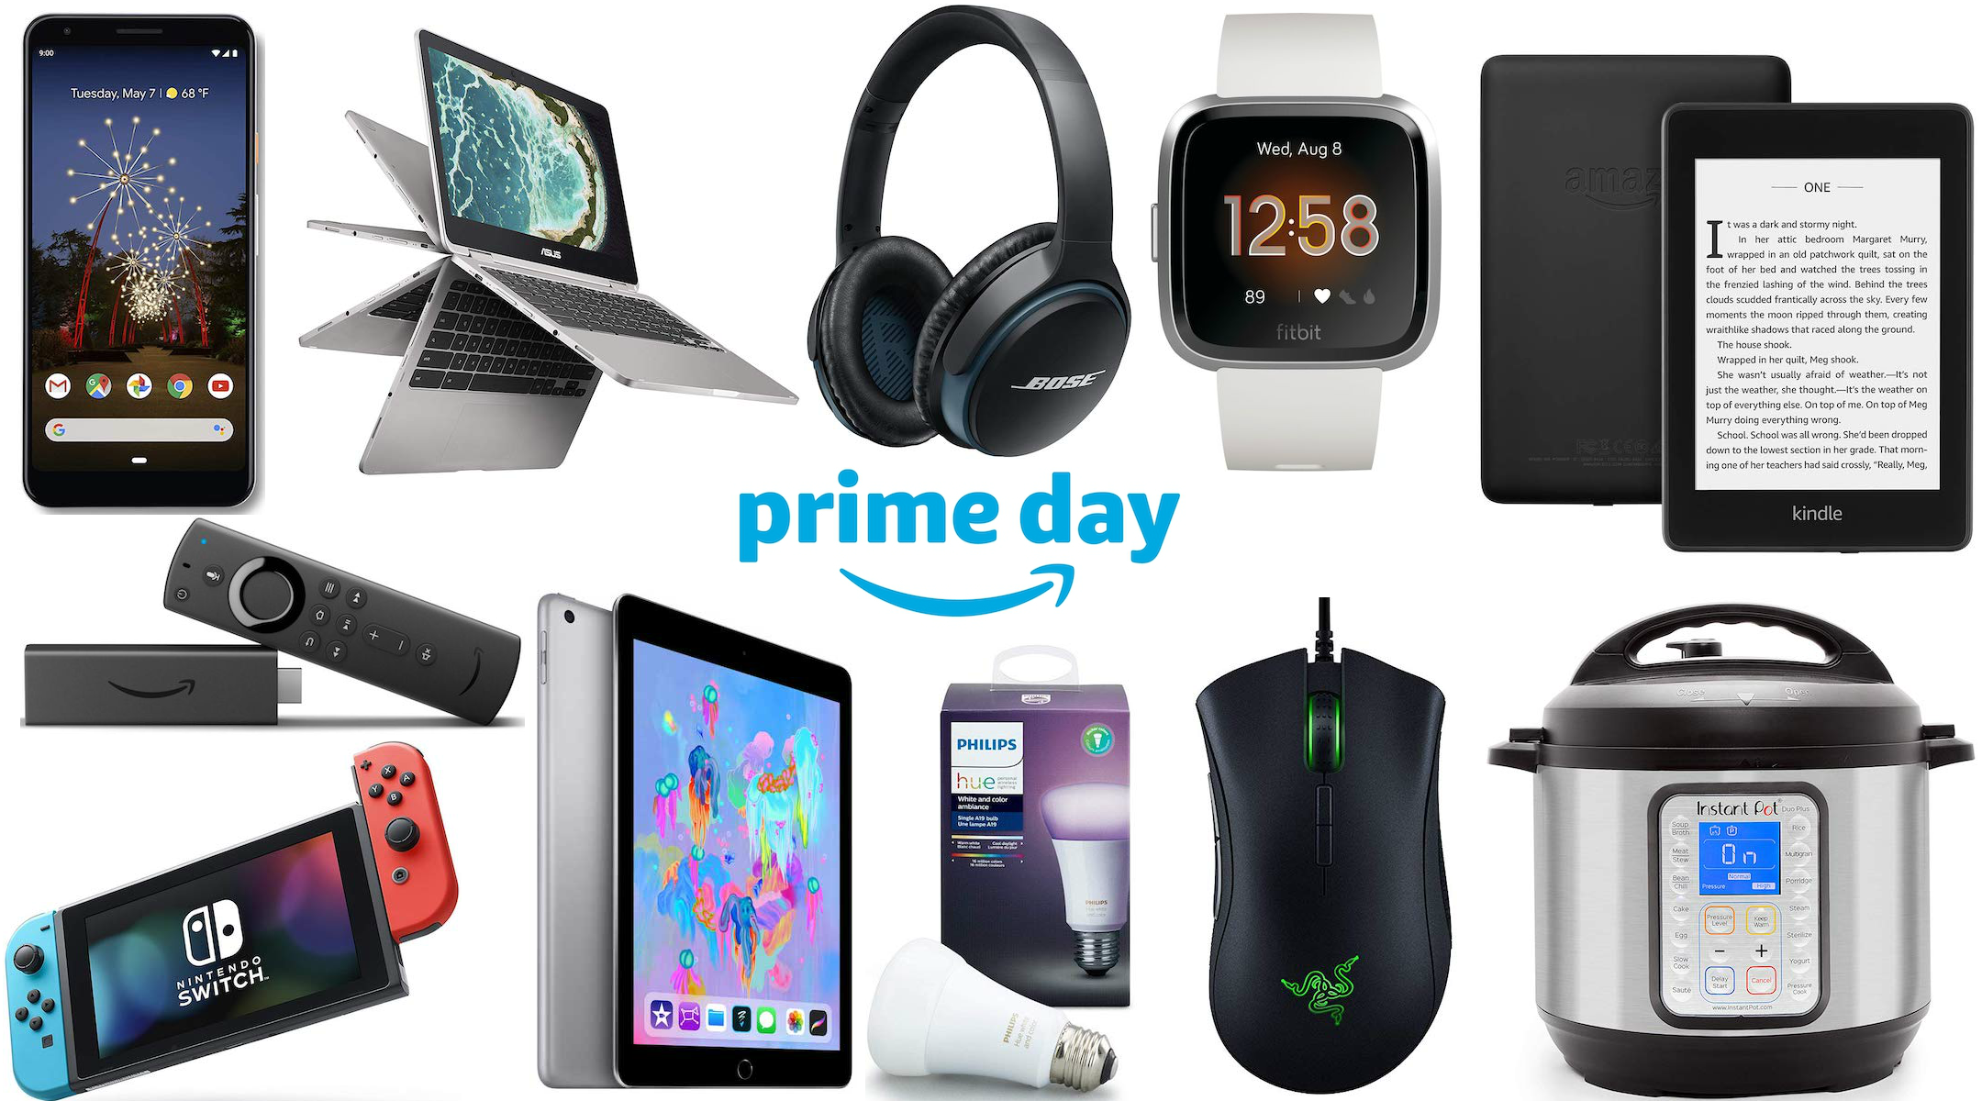
Amazon electronics

